Slide 1
EE4218 Multi-layer Perceptron Project
Key features:
6 different forward propagation implementations with different timing and resource usage characteristics
Software implementation in C – emulating 16-bit fixed point arithmetic
Hardware implementation in VHDL – using Booth’s multiplication algorithm
Hardware implementation using HLS
Hardware implementation in VHDL (fast) – using DSP block multiplication
Hardware implementation using HLS (fast) – with loop unfolding and pipelining
Hardware implementation using HLS (fast+) – with parallel memory access and computations
Implementation selection using dip switches
Push buttons to change implementation or re-input test data
Timing using AXI Timer peripheral
Shared memory between CPU (in PS) and peripherals (in PL)
Software Implementation in C
Emulate 16-bit fixed-point (8 fractional bits) arithmetic using shift operations
Example: sum = sum + (((s32)input[j] * (s32)weight[i][j]) >> 8);
Time: 0.50 ms

Slide 2
Hardware Algorithmic Optimisation
Dimensions of matrices all in powers of 2 → Optimises the finding of BRAM address locations to be done only using shift and bit selection operations
Uses more memory but since BRAM size is fixed, might as well make full use of it and reduce processing element complexity
Biases incorporated into the weights matrix by always having a ‘1’ as the last input → Achieve consecutive memory access → Reduces counter complexity
16
16
32 test sets with 13 inputs each padded to 16 fixing the last input as 1
16
32
1
biases
0
0
16
4
biases
4 output neurons for easy decoding
1
0
1
1
1 input set
15 hidden neurons to allow last hidden layer output to be a 1.
1 hidden layer output

Slide 3
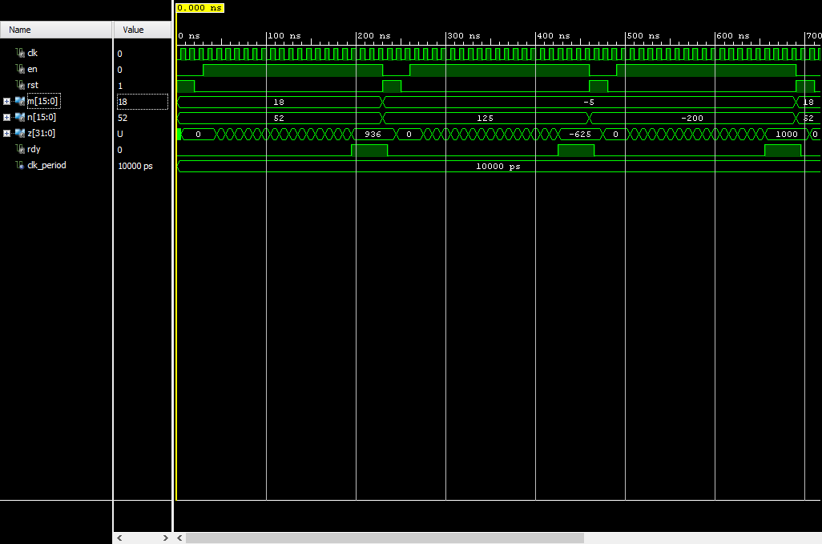
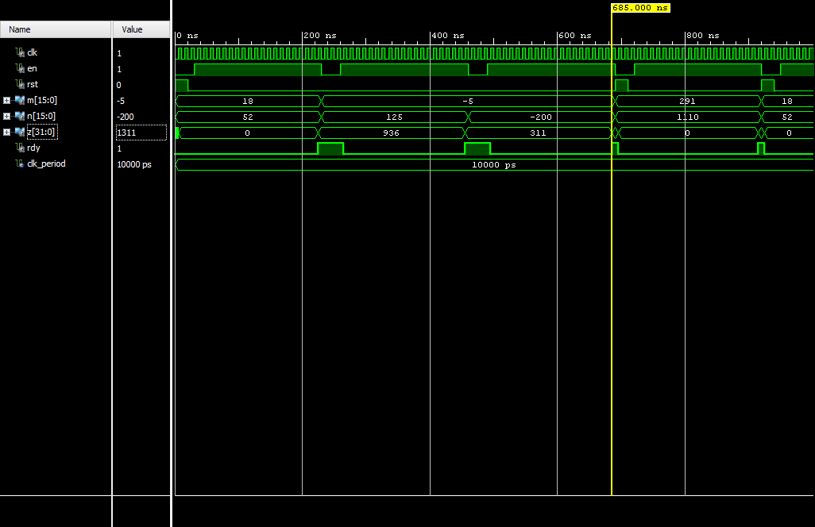
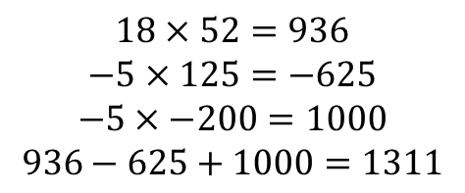
Hardware Implementation in VHDL
Booth’s multiplication algorithm
Multiply and accumulator
Multiplier Testbench
MAC Testbench
Booth’s algorithm only requires one adder(subtractor) and one shifter although the number of cycles needed is equal to the bit width of the multiplicand → minimal resource implementation
$$18×52=936$$
$$−5×125=−625$$
$$−5×−200=1000$$
$$936−625+1000=1311$$

Slide 4
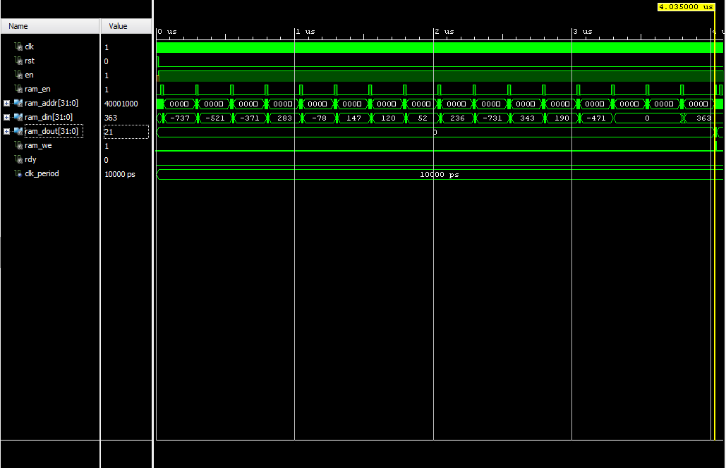
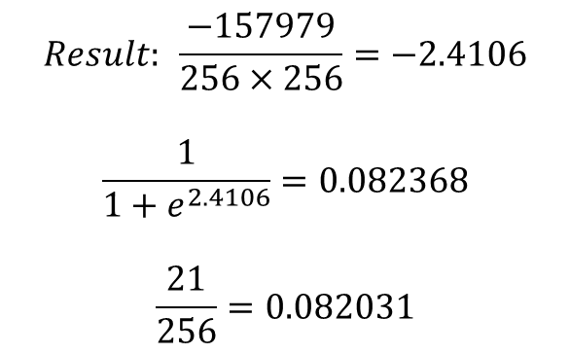
Hardware Implementation in VHDL
-737 | -521 | -371 | 283 | -78 | 147 | 120 | 52 | 236 | -731 | 343 | 190 | -471 | 0 | 0 | 363
193
89
182
84
102
144
190
55
206
143
207
196
233
0
0
256
$$Result: \frac{−157979}{256×256}=−2.4106$$
$$\frac{1}{1+e^{2.4106}}=0.082368$$
$$\frac{21}{256}=0.082031$$
Result
Write address
Input set testbench
+-----------+------+-------+-----------+-------+
| Site Type | Used | Fixed | Available | Util% |
+-----------+------+-------+-----------+-------+
| DSPs | 0 | 0 | 220 | 0.00 |
+-----------+------+-------+-----------+-------+
+-------------------------+------+-------+-----------+-------+
| Site Type | Used | Fixed | Available | Util% |
+-------------------------+------+-------+-----------+-------+
| Slice LUTs | 448 | 0 | 53200 | 0.84 |
| LUT as Logic | 448 | 0 | 53200 | 0.84 |
| LUT as Memory | 0 | 0 | 17400 | 0.00 |
| Slice Registers | 265 | 0 | 106400 | 0.25 |
| Register as Flip Flop | 265 | 0 | 106400 | 0.25 |
| Register as Latch | 0 | 0 | 106400 | 0.00 |
| F7 Muxes | 0 | 0 | 26600 | 0.00 |
| F8 Muxes | 0 | 0 | 13300 | 0.00 |
+-------------------------+------+-------+-----------+-------+
+-------------------+------+-------+-----------+-------+
| Site Type | Used | Fixed | Available | Util% |
+-------------------+------+-------+-----------+-------+
| Block RAM Tile | 5 | 0 | 140 | 3.57 |
| RAMB36/FIFO* | 5 | 0 | 140 | 3.57 |
| RAMB36E1 only | 5 | | | |
| RAMB18 | 0 | 0 | 280 | 0.00 |
+-------------------+------+-------+-----------+-------+
Time: 2.8 ms

Slide 5
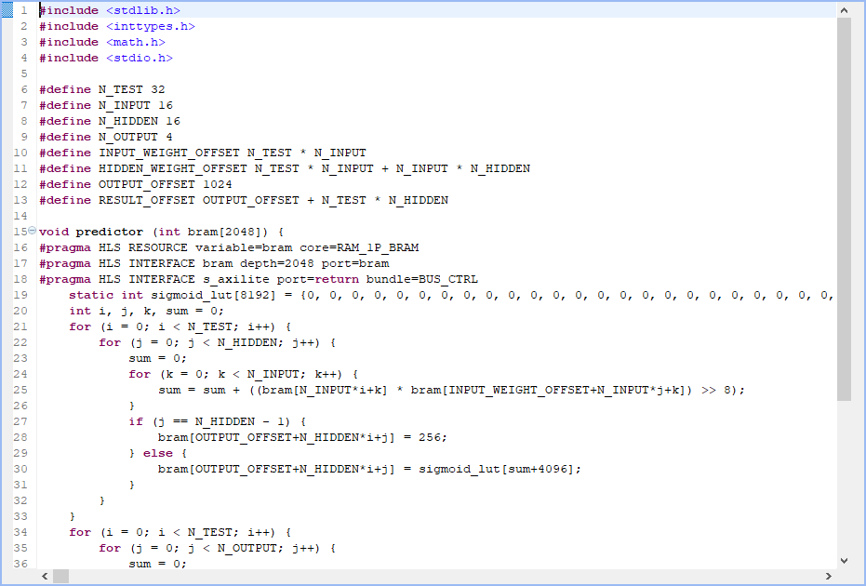
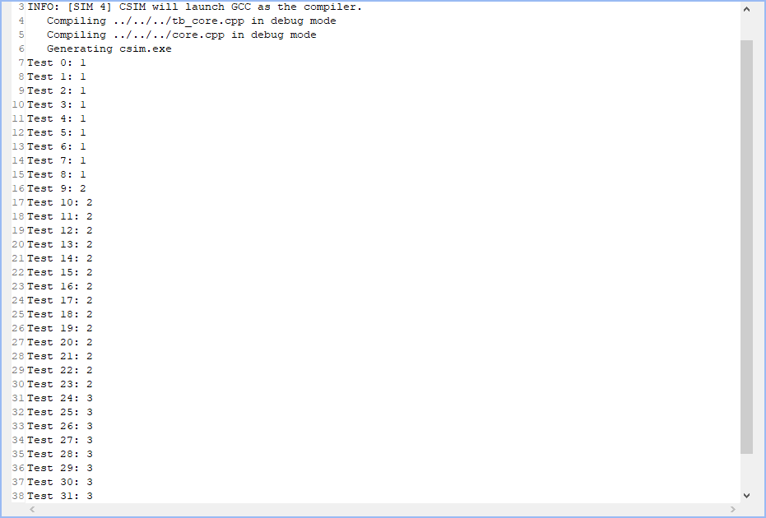
Hardware Implementation using HLS
HLS C file
C testbench
+----------------------------+------+-------+-----------+-------+
| Site Type | Used | Fixed | Available | Util% |
+----------------------------+------+-------+-----------+-------+
| Slice LUTs | 190 | 0 | 53200 | 0.36 |
| LUT as Logic | 183 | 0 | 53200 | 0.34 |
| LUT as Memory | 7 | 0 | 17400 | 0.04 |
| LUT as Distributed RAM | 0 | 0 | | |
| LUT as Shift Register | 7 | 0 | | |
| Slice Registers | 274 | 0 | 106400 | 0.26 |
| Register as Flip Flop | 274 | 0 | 106400 | 0.26 |
| Register as Latch | 0 | 0 | 106400 | 0.00 |
| F7 Muxes | 0 | 0 | 26600 | 0.00 |
| F8 Muxes | 0 | 0 | 13300 | 0.00 |
+----------------------------+------+-------+-----------+-------+
+----------------+------+-------+-----------+-------+
| Site Type | Used | Fixed | Available | Util% |
+----------------+------+-------+-----------+-------+
| DSPs | 3 | 0 | 220 | 1.36 |
| DSP48E1 only | 3 | | | |
+----------------+------+-------+-----------+-------+
+-------------------+------+-------+-----------+-------+
| Site Type | Used | Fixed | Available | Util% |
+-------------------+------+-------+-----------+-------+
| Block RAM Tile | 4 | 0 | 140 | 2.86 |
| RAMB36/FIFO* | 4 | 0 | 140 | 2.86 |
| RAMB36E1 only | 4 | | | |
| RAMB18 | 0 | 0 | 280 | 0.00 |
+-------------------+------+-------+-----------+-------+
Time: 1.2 ms

Slide 6
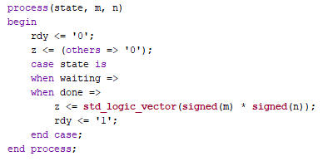
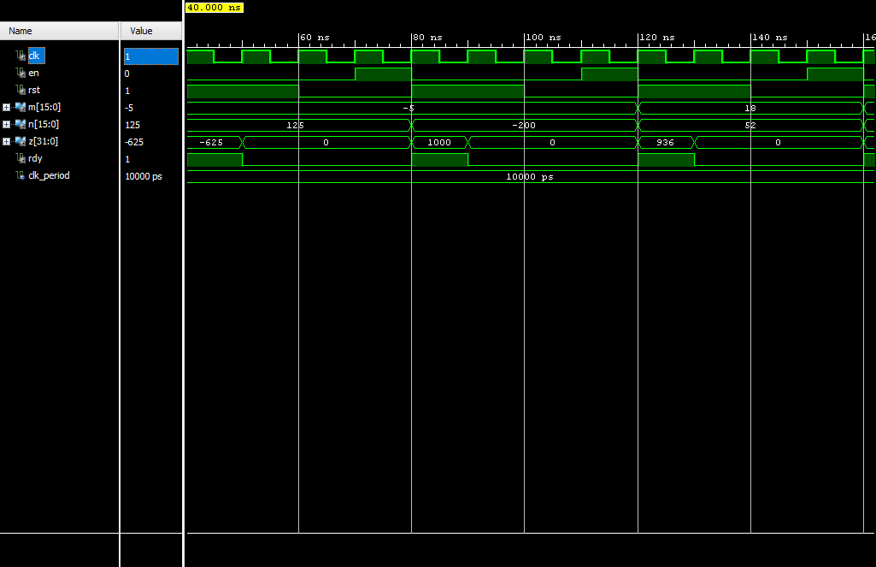
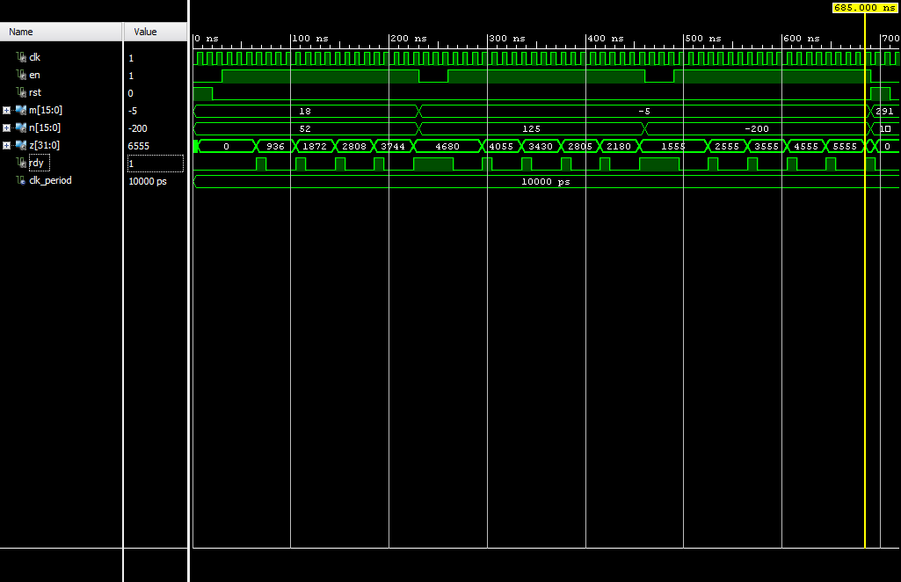
Hardware Implementation in VHDL (fast)
Use DSP block for multiplication instead of Booth’s multiplication algorithm
Multiplier Testbench
MAC Testbench

Slide 7
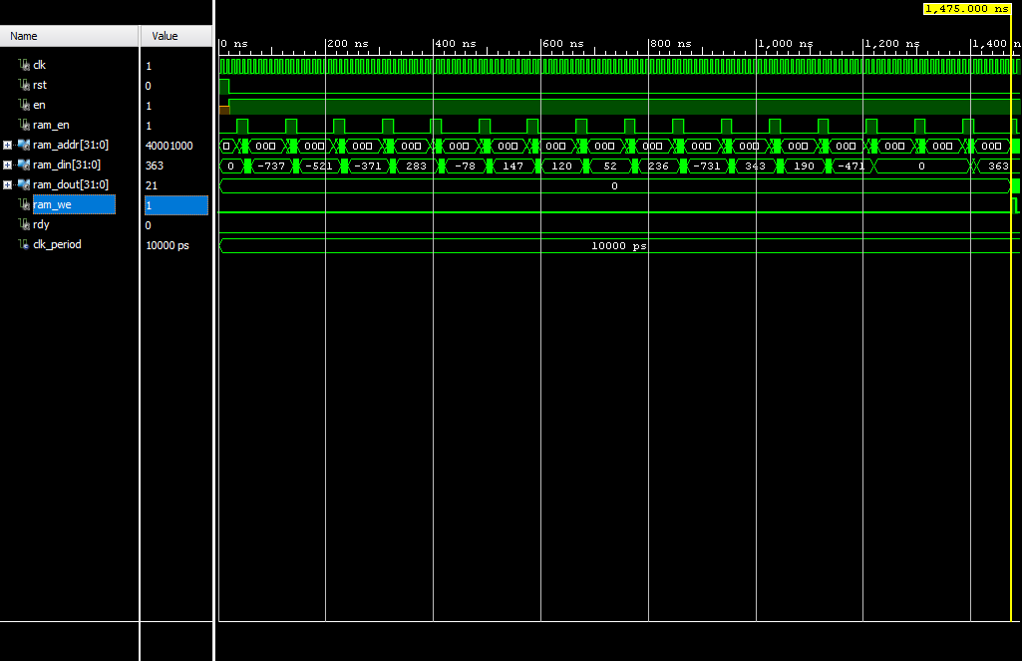
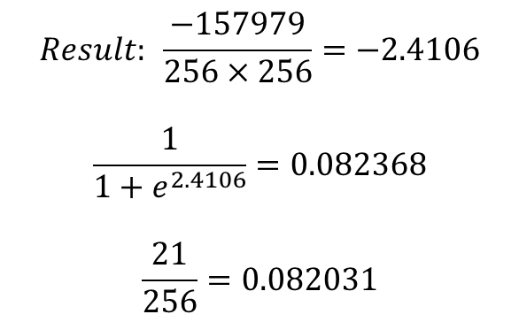
Hardware Implementation in VHDL (fast)
$$Result: \frac{−157979}{256×256}=−2.4106$$
$$\frac{1}{1+e^{2.4106}}=0.082368$$
$$\frac{21}{256}=0.082031$$
Result
Write address
Input set testbench
+----------------+------+-------+-----------+-------+
| Site Type | Used | Fixed | Available | Util% |
+----------------+------+-------+-----------+-------+
| DSPs | 2 | 0 | 220 | 0.91 |
| DSP48E1 only | 2 | | | |
+----------------+------+-------+-----------+-------+
+-------------------------+------+-------+-----------+-------+
| Site Type | Used | Fixed | Available | Util% |
+-------------------------+------+-------+-----------+-------+
| Slice LUTs | 244 | 0 | 53200 | 0.46 |
| LUT as Logic | 244 | 0 | 53200 | 0.46 |
| LUT as Memory | 0 | 0 | 17400 | 0.00 |
| Slice Registers | 125 | 0 | 106400 | 0.12 |
| Register as Flip Flop | 125 | 0 | 106400 | 0.12 |
| Register as Latch | 0 | 0 | 106400 | 0.00 |
| F7 Muxes | 0 | 0 | 26600 | 0.00 |
| F8 Muxes | 0 | 0 | 13300 | 0.00 |
+-------------------------+------+-------+-----------+-------+
+-------------------+------+-------+-----------+-------+
| Site Type | Used | Fixed | Available | Util% |
+-------------------+------+-------+-----------+-------+
| Block RAM Tile | 5 | 0 | 140 | 3.57 |
| RAMB36/FIFO* | 5 | 0 | 140 | 3.57 |
| RAMB36E1 only | 5 | | | |
| RAMB18 | 0 | 0 | 280 | 0.00 |
+-------------------+------+-------+-----------+-------+
Time: 1.2 ms

Slide 8
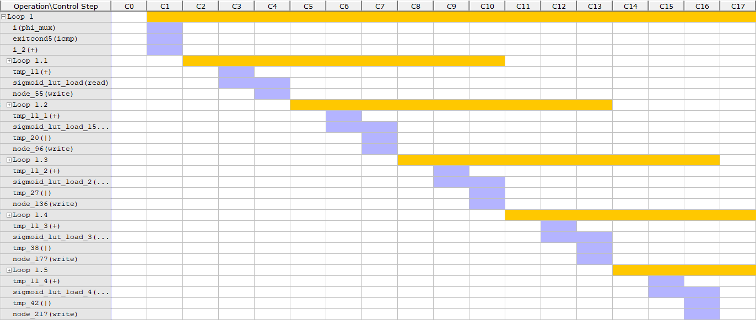
Hardware Implementation using HLS (fast)
Use loop unfolding and pipelining PRAGMA in HLS – increases computation parallelism
Loop unfolding
Loop pipelining
int sum = 0;
for (int i = 0; i < 10; i++) {
sum += a[i];
}
int sum = 0;
for (int i = 0; i < 10; i += 2) {
sum += a[i];
sum += a[i + 1];
}
Multiple iterations in one loop cycle
Starting the next iteration before the previous one is complete
+----------------------------+------+-------+-----------+-------+
| Site Type | Used | Fixed | Available | Util% |
+----------------------------+------+-------+-----------+-------+
| Slice LUTs | 1184 | 0 | 53200 | 2.23 |
| LUT as Logic | 1161 | 0 | 53200 | 2.18 |
| LUT as Memory | 23 | 0 | 17400 | 0.13 |
| LUT as Distributed RAM | 0 | 0 | | |
| LUT as Shift Register | 23 | 0 | | |
| Slice Registers | 860 | 0 | 106400 | 0.81 |
| Register as Flip Flop | 860 | 0 | 106400 | 0.81 |
| Register as Latch | 0 | 0 | 106400 | 0.00 |
| F7 Muxes | 0 | 0 | 26600 | 0.00 |
| F8 Muxes | 0 | 0 | 13300 | 0.00 |
+----------------------------+------+-------+-----------+-------+
+----------------+------+-------+-----------+-------+
| Site Type | Used | Fixed | Available | Util% |
+----------------+------+-------+-----------+-------+
| DSPs | 3 | 0 | 220 | 1.36 |
| DSP48E1 only | 3 | | | |
+----------------+------+-------+-----------+-------+
+-------------------+------+-------+-----------+-------+
| Site Type | Used | Fixed | Available | Util% |
+-------------------+------+-------+-----------+-------+
| Block RAM Tile | 4 | 0 | 140 | 2.86 |
| RAMB36/FIFO* | 4 | 0 | 140 | 2.86 |
| RAMB36E1 only | 4 | | | |
| RAMB18 | 0 | 0 | 280 | 0.00 |
+-------------------+------+-------+-----------+-------+
Time: 0.45 ms

Slide 9
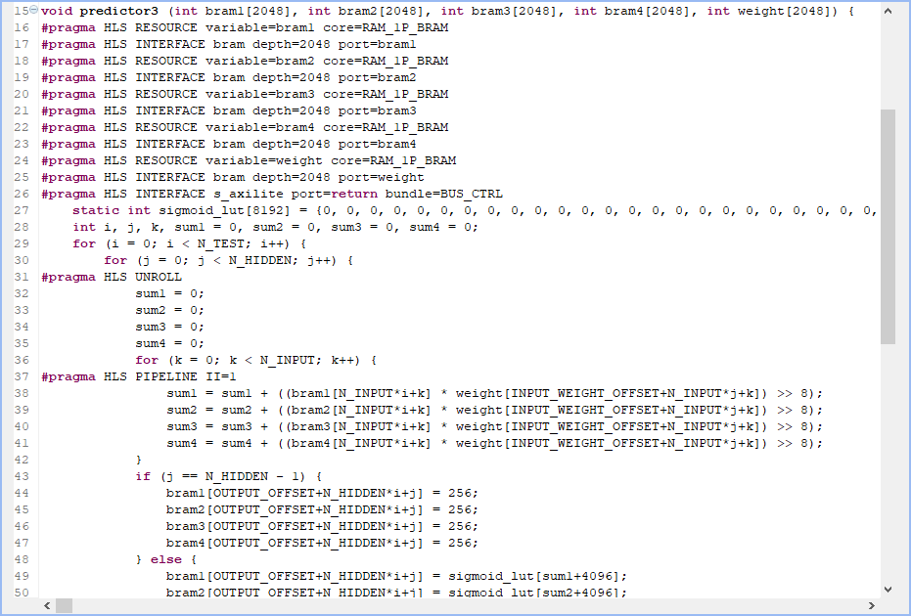
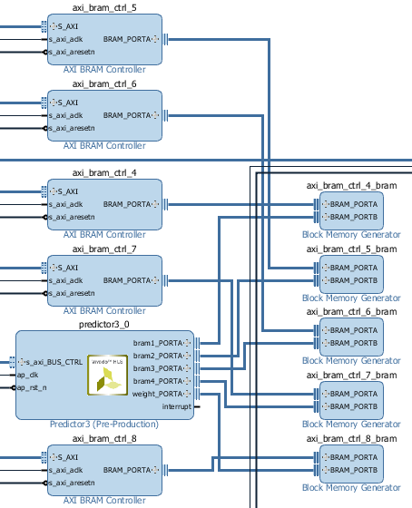
Hardware Implementation using HLS (fast+)
Emulating a Single Instruction, Multiple Data (SIMD) architecture by enabling parallel access of input data and performing parallel computations – reduce memory access and computation time (Used in GPUs)
+----------------------------+------+-------+-----------+-------+
| Site Type | Used | Fixed | Available | Util% |
+----------------------------+------+-------+-----------+-------+
| Slice LUTs | 1973 | 0 | 53200 | 3.71 |
| LUT as Logic | 1917 | 0 | 53200 | 3.60 |
| LUT as Memory | 56 | 0 | 17400 | 0.32 |
| LUT as Distributed RAM | 0 | 0 | | |
| LUT as Shift Register | 56 | 0 | | |
| Slice Registers | 1546 | 0 | 106400 | 1.45 |
| Register as Flip Flop | 1546 | 0 | 106400 | 1.45 |
| Register as Latch | 0 | 0 | 106400 | 0.00 |
| F7 Muxes | 5 | 0 | 26600 | 0.02 |
| F8 Muxes | 0 | 0 | 13300 | 0.00 |
+----------------------------+------+-------+-----------+-------+
+----------------+------+-------+-----------+-------+
| Site Type | Used | Fixed | Available | Util% |
+----------------+------+-------+-----------+-------+
| DSPs | 12 | 0 | 220 | 5.45 |
| DSP48E1 only | 12 | | | |
+----------------+------+-------+-----------+-------+
+-------------------+------+-------+-----------+-------+
| Site Type | Used | Fixed | Available | Util% |
+-------------------+------+-------+-----------+-------+
| Block RAM Tile | 14 | 0 | 140 | 10.0 |
| RAMB36/FIFO* | 14 | 0 | 140 | 10.0 |
| RAMB36E1 only | 14 | | | |
| RAMB18 | 0 | 0 | 280 | 0.00 |
+-------------------+------+-------+-----------+-------+
Time: 0.25 ms

Slide 10
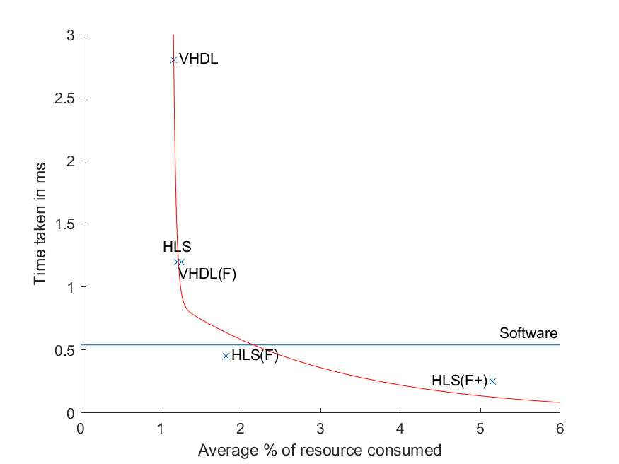
Comparison
Resource-time trade-off
Can throw more resources at the problem to reduce time taken
Given the simplicity of the combinational logic in the first VHDL implementation, it might be possible to increase clock rate to improve speed
In reality, FPGAs already have the different areas allocated to different blocks → if everything fits, there’s not much need to optimise for area → you should maximise all resources to achieve lowest possible timing, unless power consumption is a consideration
$$Average \% of resource consumed=\frac{\% LUT used+\% Reg used+\%BRAM used+\%DSP used}{4}$$

